Slide 1
U.S. International Trade
Team Cool Kids
Dinh Vuong
Kash Santos
Emma Kong
Eugene Miao

Slide 2
Question
In the USA, what is the most imported and exported product?
When is the peak season for import and export?
↓
What kinds of factors can affect those seasonality and trading volume?

Slide 3
Understanding the API and Data Domain for International Trade

Slide 4
Database
Census.gov
There are 9 API Endpoints to request different type of dataset.
https://api.census.gov/data/timeseries/intltrade/exports/[dataset]
https://api.census.gov/data/timeseries/intltrade/imports/[dataset]
Census provides well-documented guideline for the user.
Parameters
76 parameters for import
56 parameters for export
Most of parameters are limited to use for specific endpoint
Time Frame
It ranges from 2003 January till 2018 March

Slide 5
Understanding the Data
Product Code
Harmonized System (HS)
North American Industry Classification System (NAICS)
Advanced Technology Code (Hi-Tech)
Department of Agriculture Code (USDA)
Standard International Trade Classification (SITC)
Product Description
Total Value by Month/Year
Timeframe (Month/Year)

Slide 6
Country Groupings
Organisation for Economic Cooperation and Development (OECD)
37 countries
Asia-Pacific Economic Cooperation (APEC)
21 countries

Slide 7
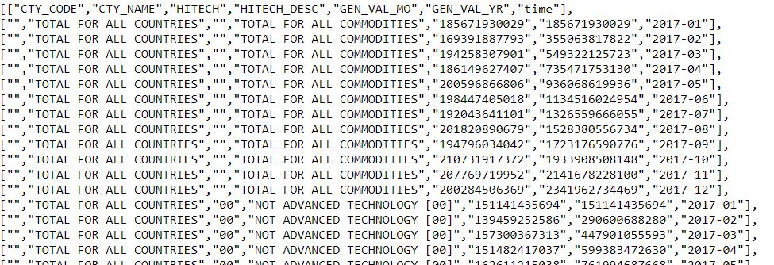
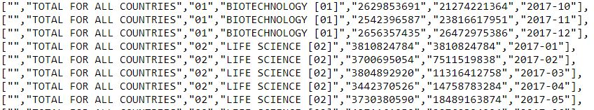
Data Makeover
Before

Slide 8
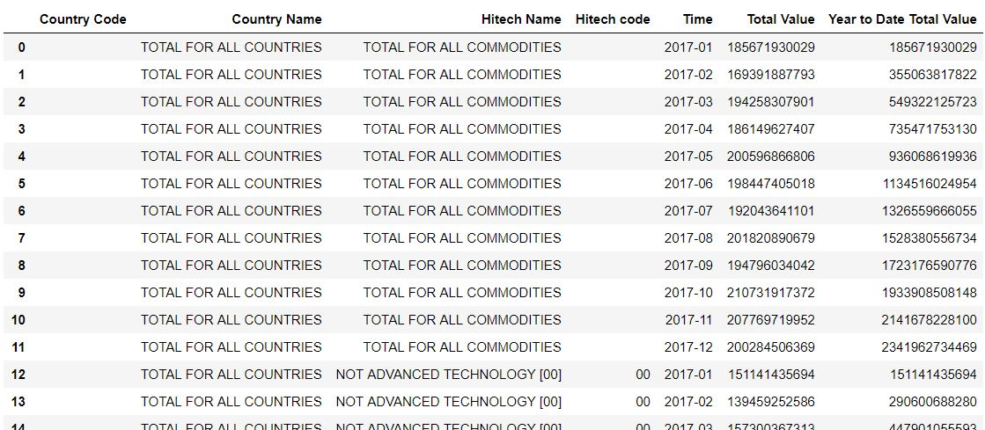
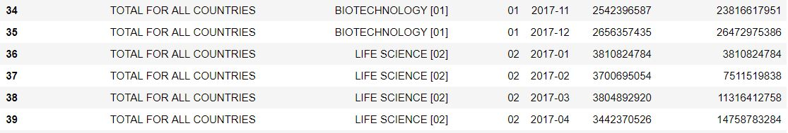
Data Makeover
After

Slide 9
Census International Trading Data Analysis
Hitech products in 2017

Slide 10
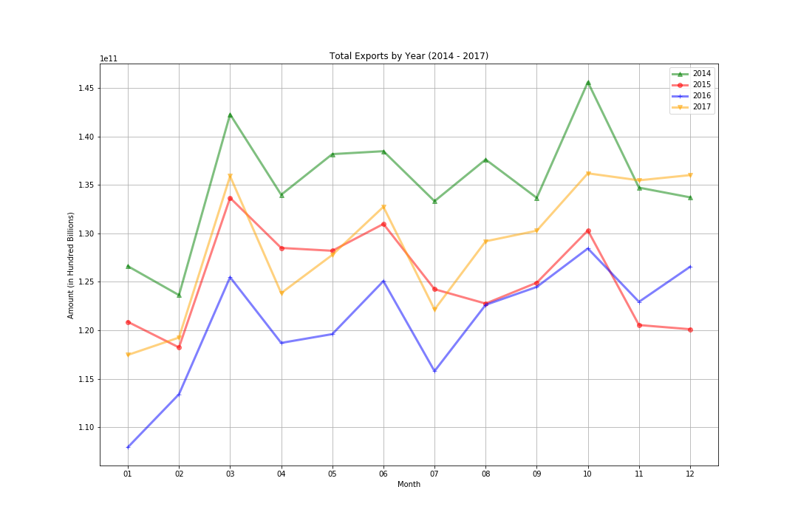
Exported Products
Max Export: Organisation for Economic Co-operation and Development - $1,013,515,710,030.00
Min Export : PITCAIRN ISLANDS - $1,431.00

Slide 11
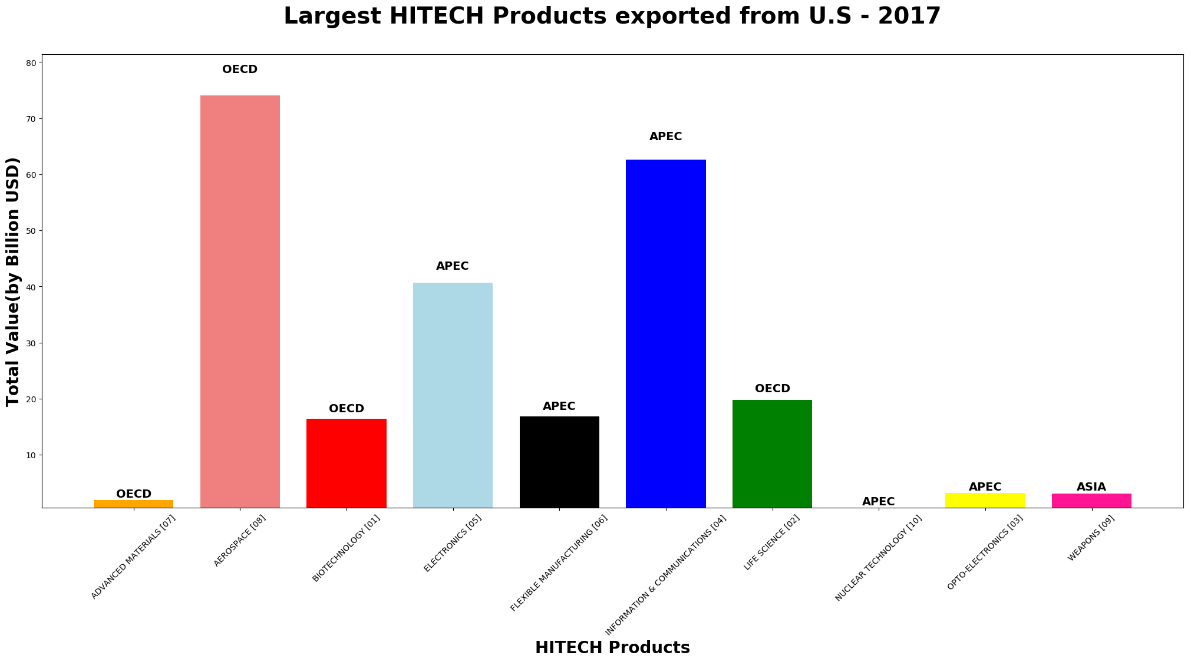
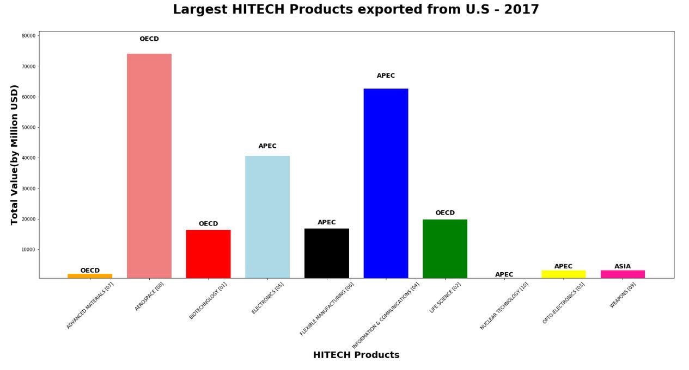
Highest Exported Hi-Tech Product?

Slide 12
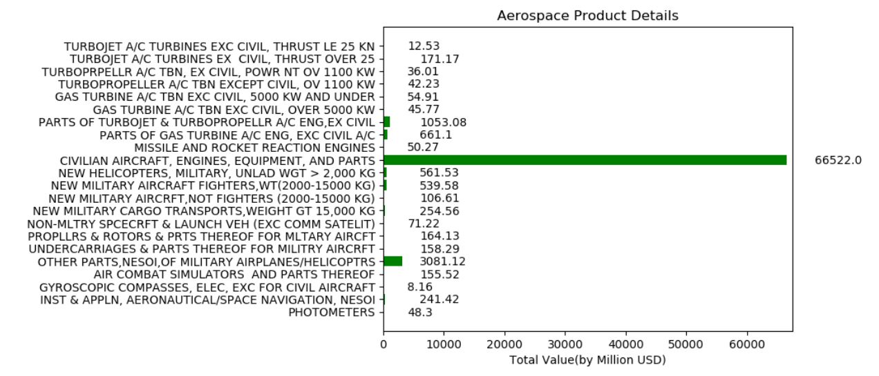
Highest Exported “Aerospace” Product?

Slide 13
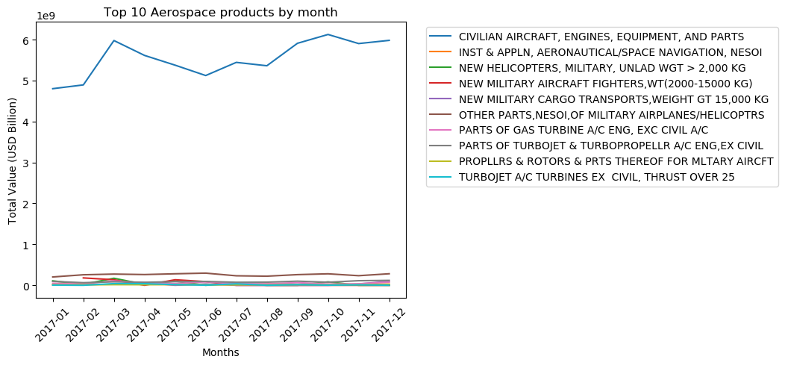
Aerospace Product by Month

Slide 14
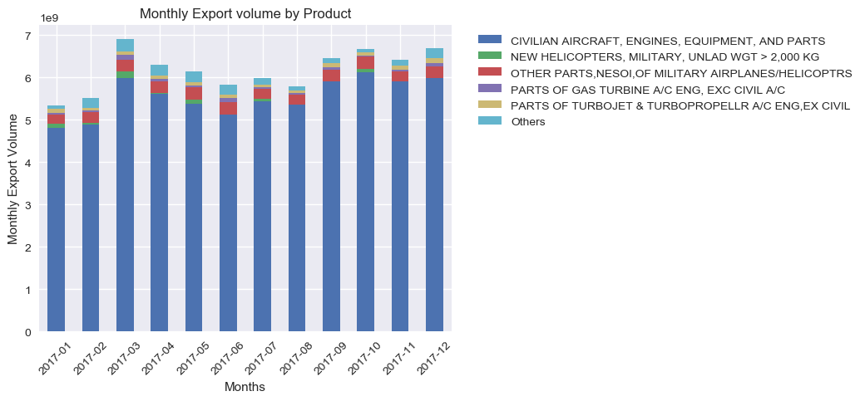
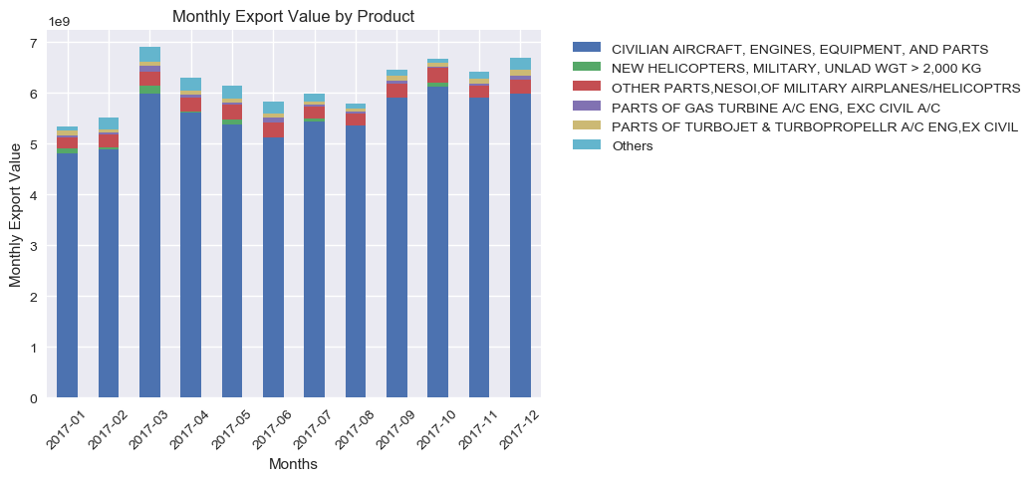
Comparison of top 5 Aerospace Products
Lowest: January
Highest: March

Slide 15
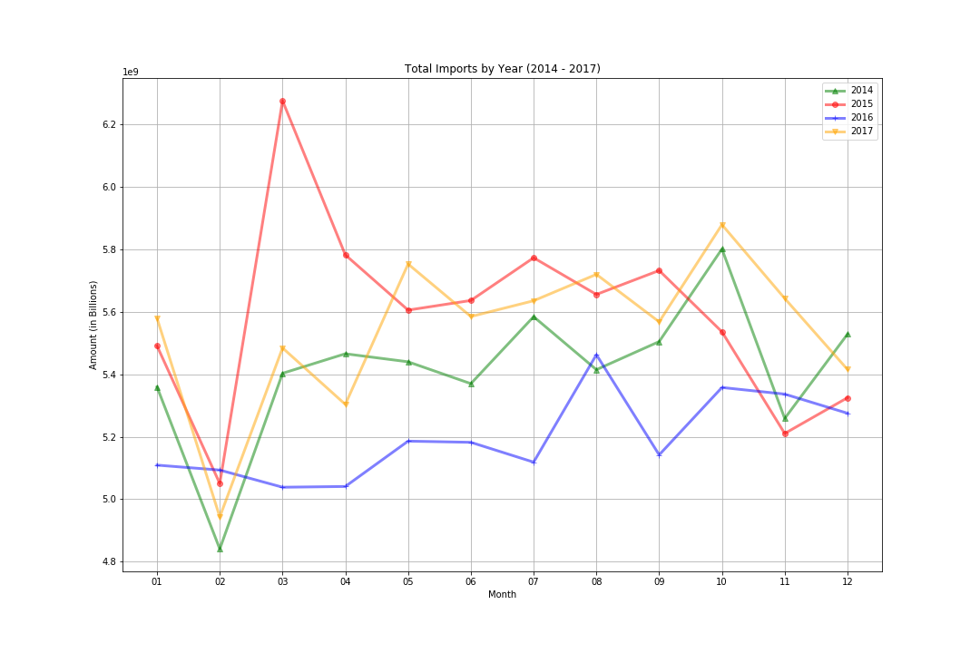
Imported Products
Max Import: Asia-Pacific Economic Cooperation -$45,199,652,863.00
Min Import: Western Sahara - $266.00

Slide 16
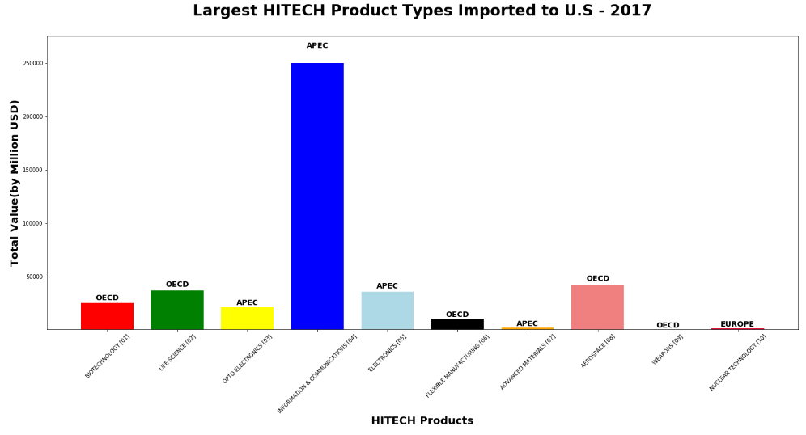
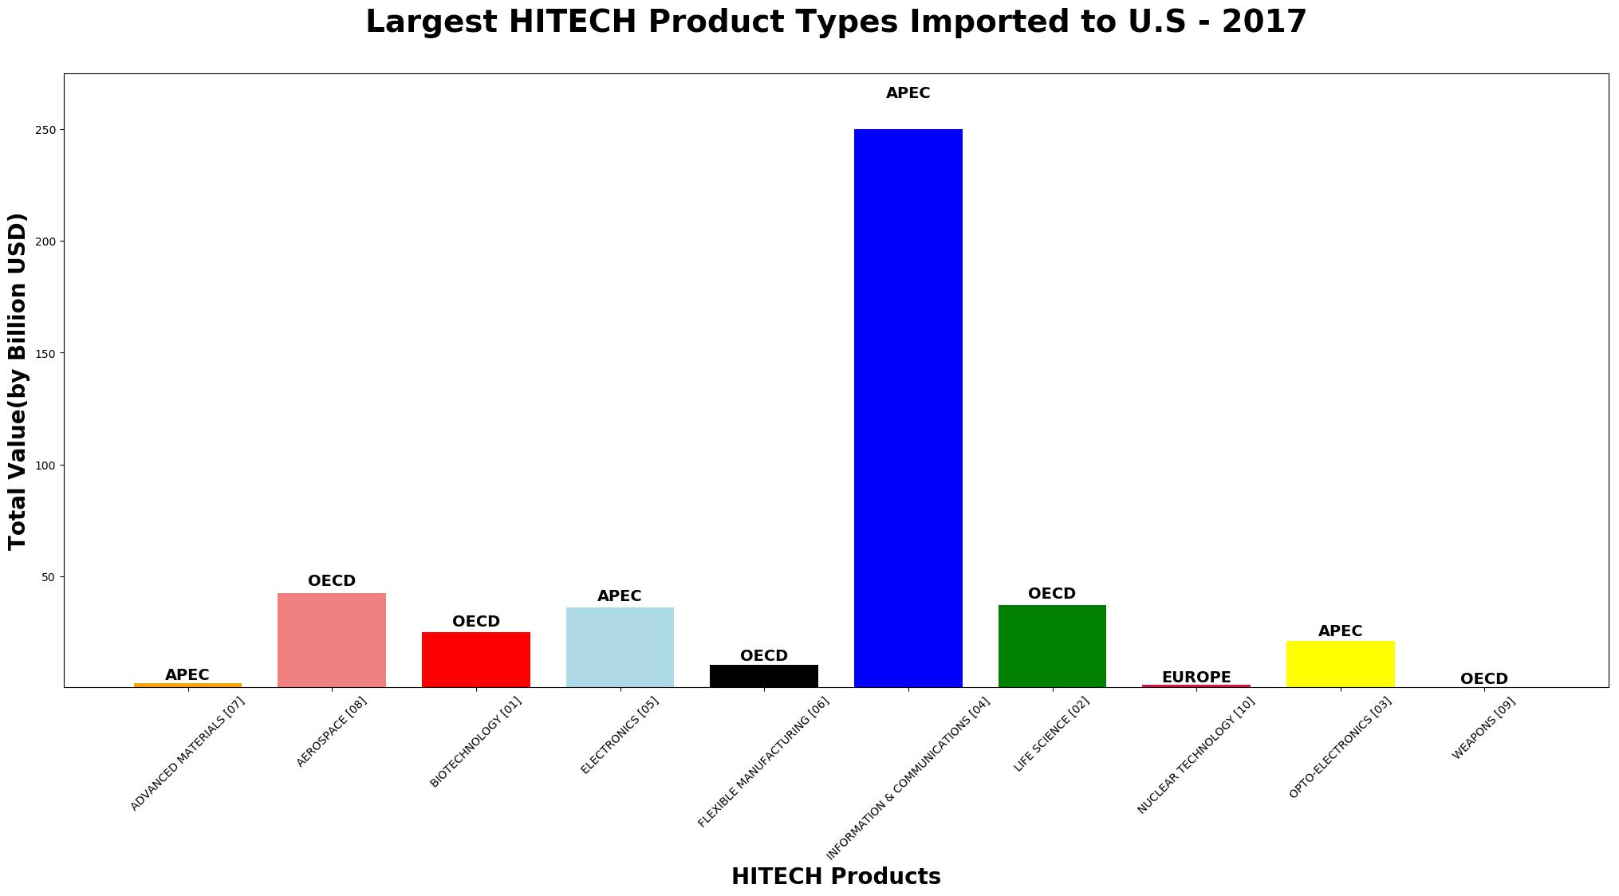
Highest Imported Hi-Tech Product?

Slide 17
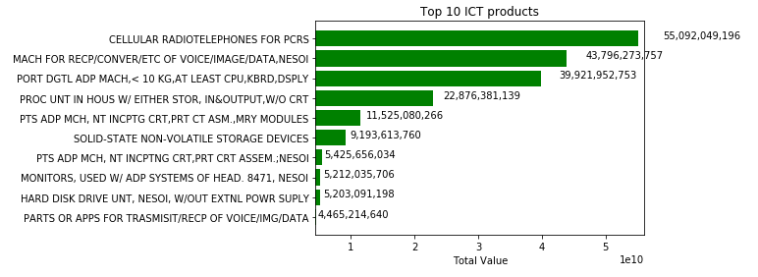
Highest Imported “Information & Communication” Product

Slide 18
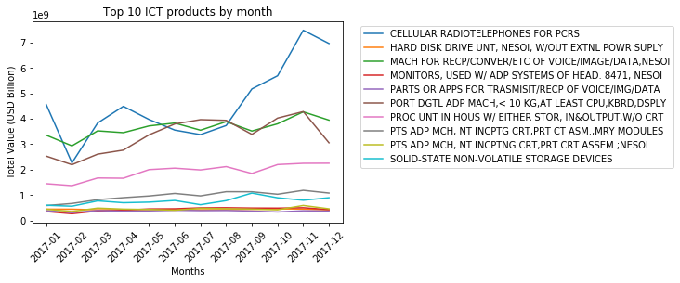
Information & Communication by Month

Slide 19
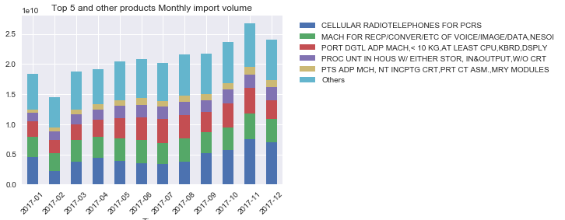
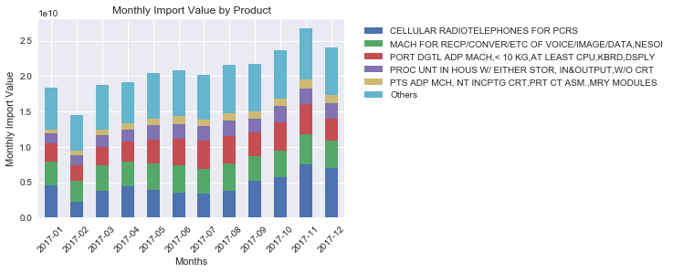
Comparison of Top 5 Info & Comm Products
Lowest: February
Highest: November

Slide 20
Challenges & Difficulties

Slide 21
Data Limitation
TOO MUCH DATA
Initially wanted to check products by continent & country
Long wait times to pull from api
Difficulty identifying/matching products by Product Code
Different Product Classification Systems (2,4,6,8,10 digit codes)
Domain unknown
Various backgrounds – none involving trade or economics

Slide 22
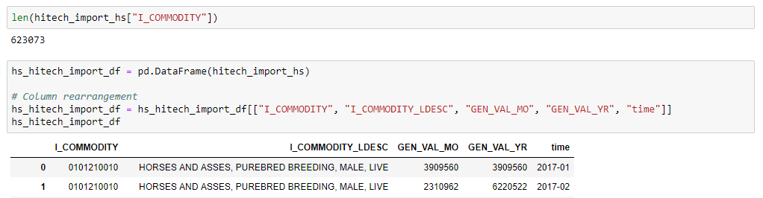
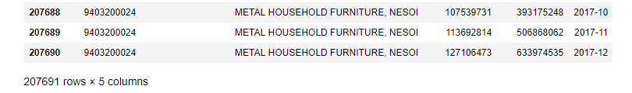
Volume of data

Slide 23
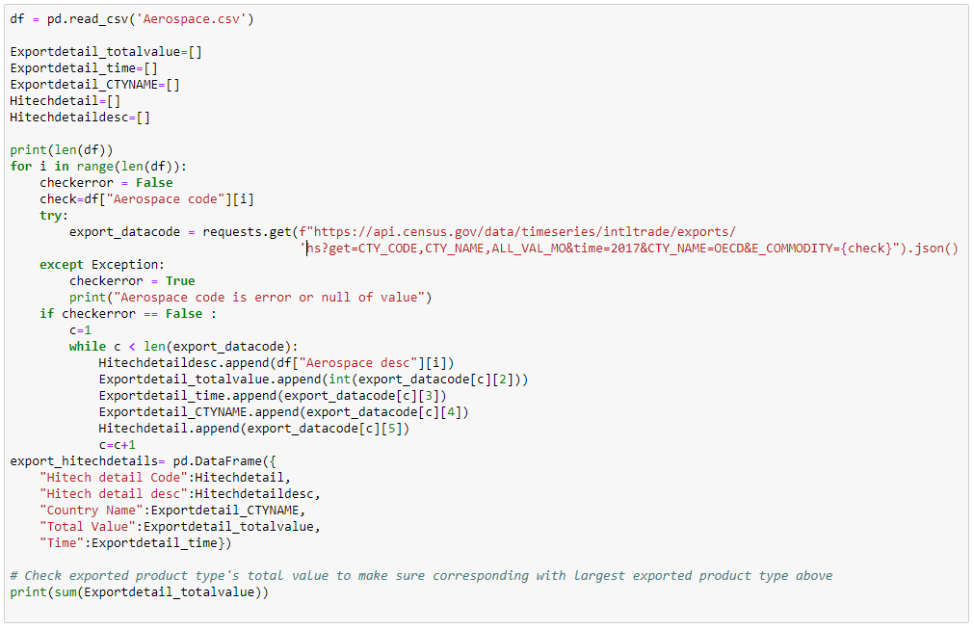
Complicated codes (Even after the optimization)

Slide 24
Conclusion
What is the most imported and exported product?
Import – Cellular Radiotelephones for PCR (APEC)
Export – Civilian Aircraft, Engines, Equipment, and Parts (OECD)
When is the peak season for import and export?
Import – November (Autumn)
Export – March (Spring, 1st quarter of the year)
What kinds of factors can affect those seasonality and trading volume?
Speculation – Weather, Trade Agreements
Further Analysis Required

Slide 25
What Now?
Too much data = Future Potential
Seasonal Influences
Expanding the time frame
Linking imports/exports with specific company announcements
e.g. Apple iPhone, Western Digital SSD
Different Parameters available
Further Analysis at a State & City level
Method of Transportation
Identify which parts of the US import/export a particular product

